Slide 1
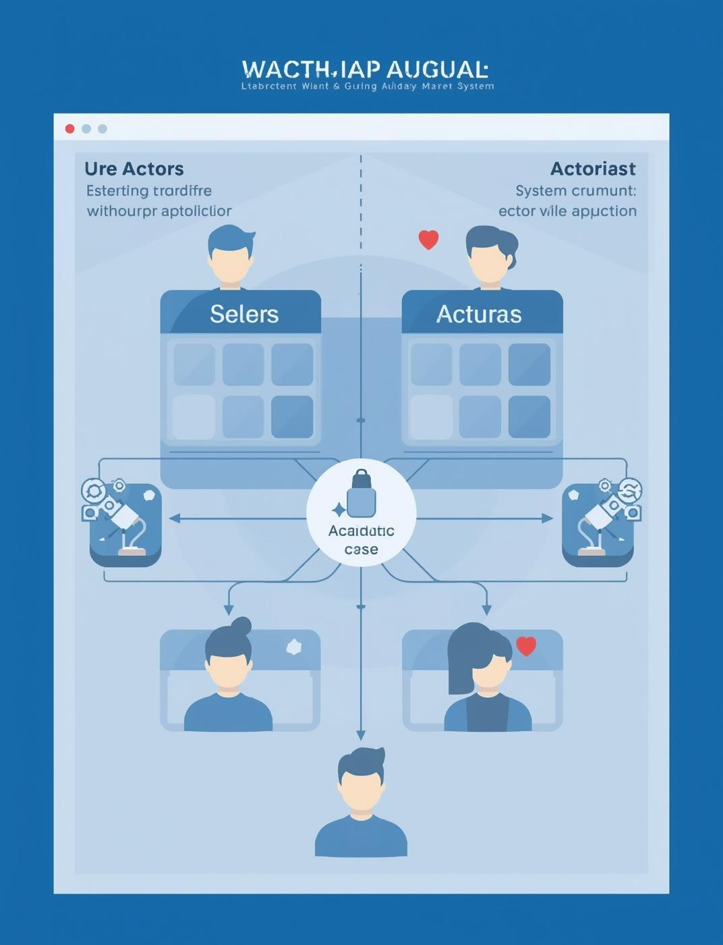
Introduction to Use Case Diagrams
Understanding System Modeling Concepts

Slide 2

Key Components of Use Case Diagrams
Actors
Use Cases
System Boundary
The system boundary delineates what is included in the system versus what is external. It visually defines the scope of the system, aiding in understanding its limits and interactions.
Actors represent users or systems that interact with the application. They can be external entities that trigger use cases, showcasing their roles within the system.
Use cases define the specific actions or tasks that actors can perform. Each use case describes a scenario, demonstrating how the system responds to actor interactions.

Slide 3

Relationships
Association
Understanding connections in Use Case Diagrams
Represents direct interactions between actors and use cases.
Include
Specifies that a use case contains another use case.
Extend
Adds optional behavior that enhances a use case.
Generalization
Depicts a hierarchy between actors or use cases.

Slide 4

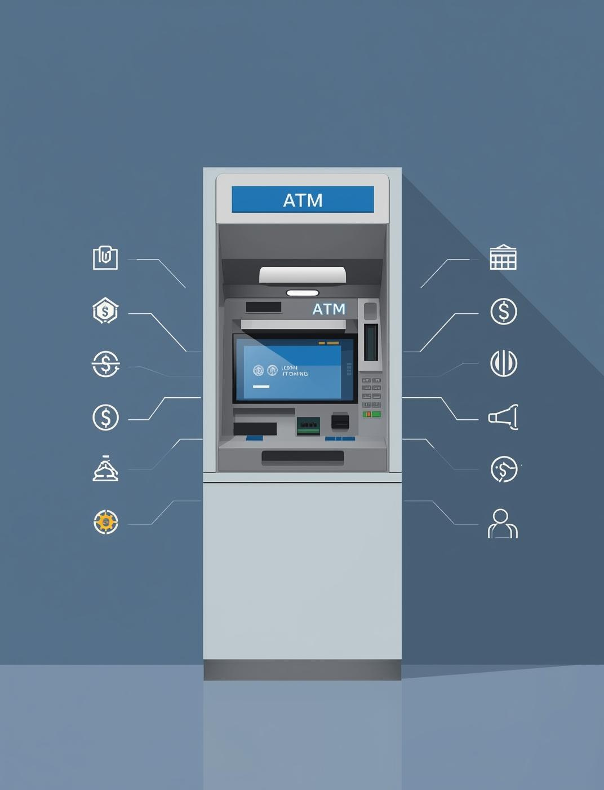
ATM System Overview
Understanding Customer Interactions and Transactions
This diagram illustrates the key interactions between a customer and the bank system, showcasing essential use cases like withdrawing funds, depositing money, and checking account balances.

Slide 5

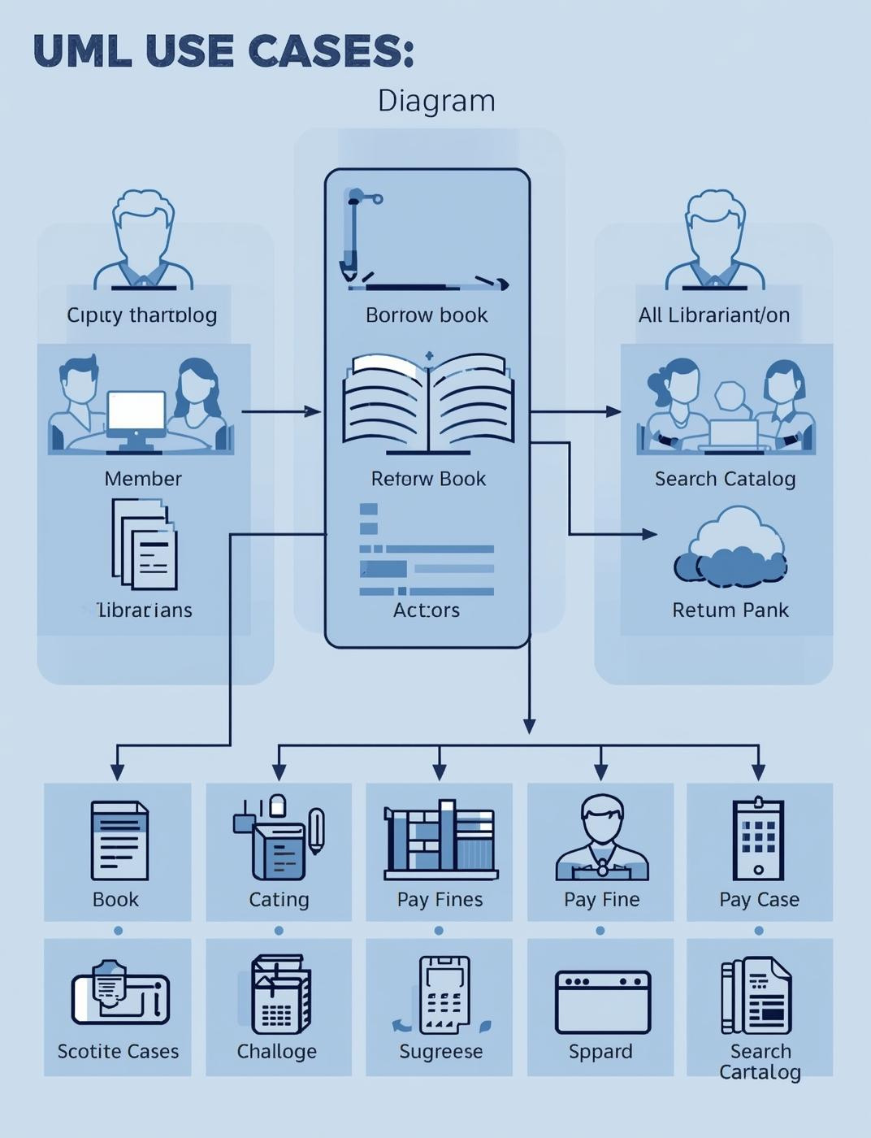
Library Management System
Understanding Key Actors and Use Cases
This diagram outlines essential interactions in a Library Management System, highlighting how members and librarians engage with various functionalities such as borrowing and returning books.

Slide 6
Steps to Draw
01
02
03
Identify Actors
Identify Use Cases
Draw System Boundary
Determine who interacts with the system
Define what actions they perform
Outline the system's scope visually

Slide 7
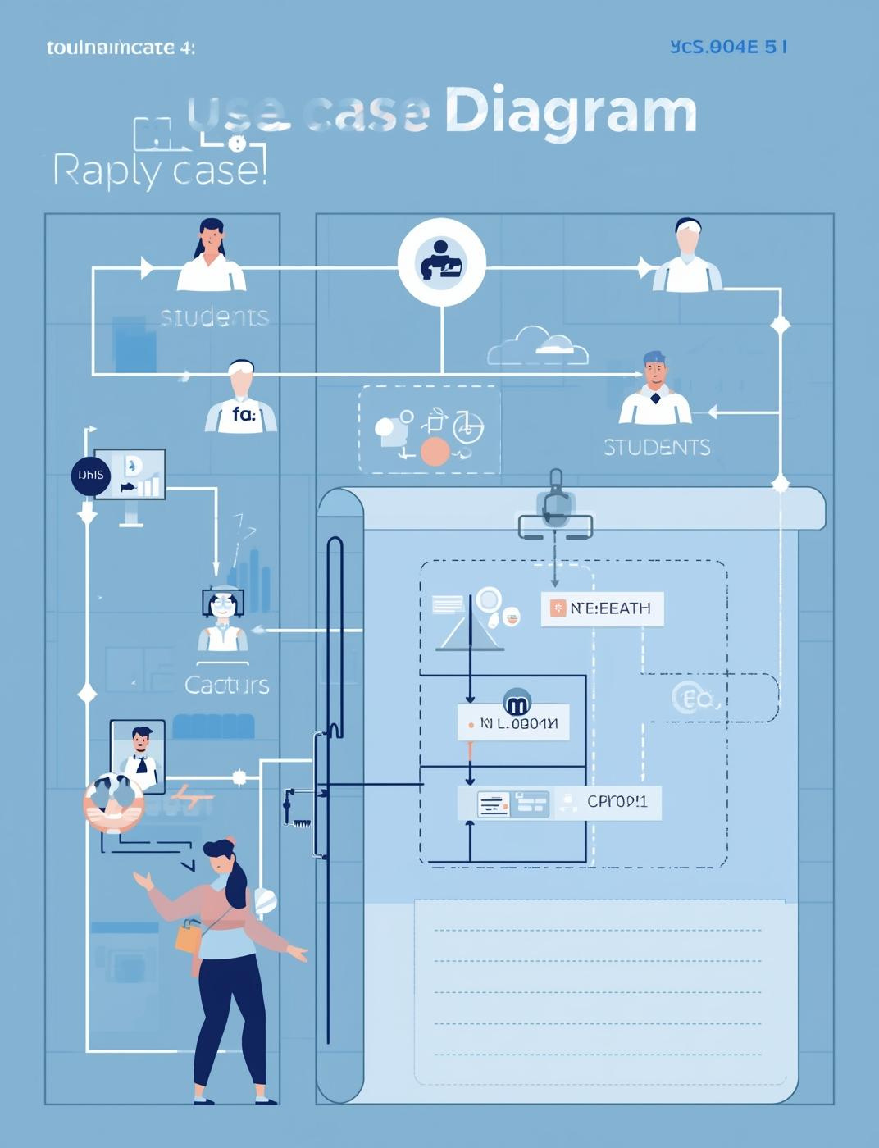
Class Activity
Apply Your Knowledge in Groups
SCL

Slide 8

Summary & Takeaway
Purpose of Use Case
Clarifies system requirements through visual representation.
Key Concepts of Use Case Diagrams Explained
Key Elements
Actors and use cases define system interactions clearly.
Relationships
Connections show how elements interact and relate.
Real-world Examples
Practical applications enhance understanding and usability.

Slide 9

Thank You
Stay connected for more insights

